Slide 1
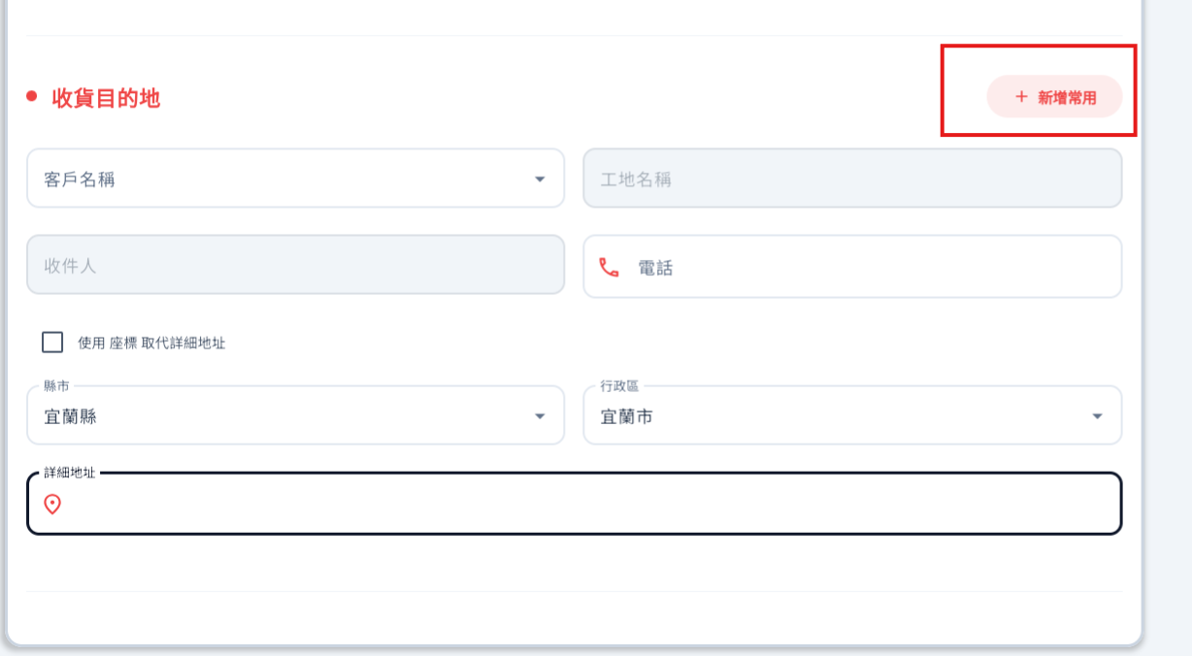
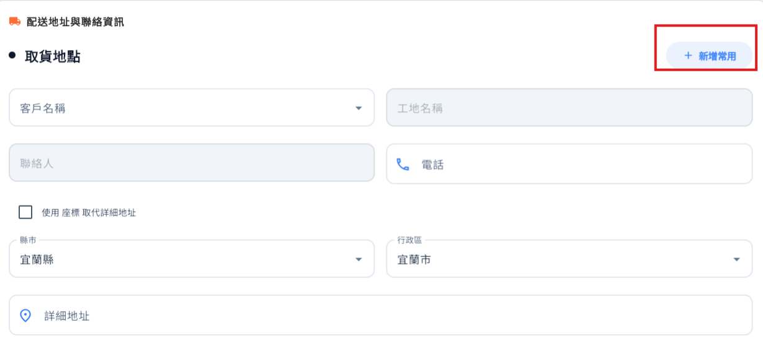
訂購WEB > 收/取貨的 新增常用
1.新增客戶 的按鈕大一點
2. *備註新用戶請新增
3.工地名稱不一定需可null
4. 電話號碼要檢查

Slide 2

mark/contect/create
Server | Method | Request Param | Response Param
https://localhost: | Post | public class ContentInsertRow { public int cityId public int districtId public int userId public string depName public string? facName public string address public string acceptUser public string acceptPhone public string lng public string lat //public string googleUrl } | public class Data { public int userId public int state public string sha256Token }

Slide 3
mark/contect/update
Server | Method | Request Param | Response Param
https://localhost: | Post | public class Content { public int cityId public int districtId public int locationId public string depName public string? facName public string address public string acceptUser public string acceptPhone public string lng public string lat public string googleUrl } | 未調整

Slide 4
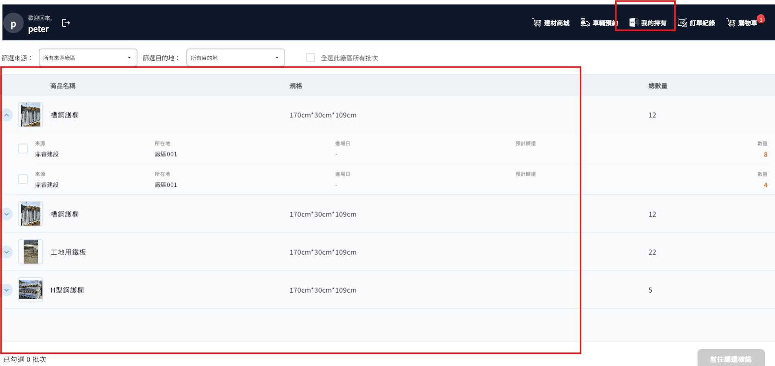
訂購平台 退還
依地址當項目 來看 商品

Slide 5
mark/order/user/own
Server | Method | Request Param | Response Param
https://localhost: | GET | userId INT cityId INT? districtId INT? | List<UserOwn>> ------------------------------------ public class UserOwn { public string addr public List<SoItem> soItems public class SoItem { public long soItemId public int shelfId public string shelfNo public string shelfName public string attrName public string fsId public int totalCount public int depId public string deptNo public string deptName public int facId public string facNo public string facName public DateTime? arrivalDt public DateTime? orderSchBackDt public int qty } }

Slide 6
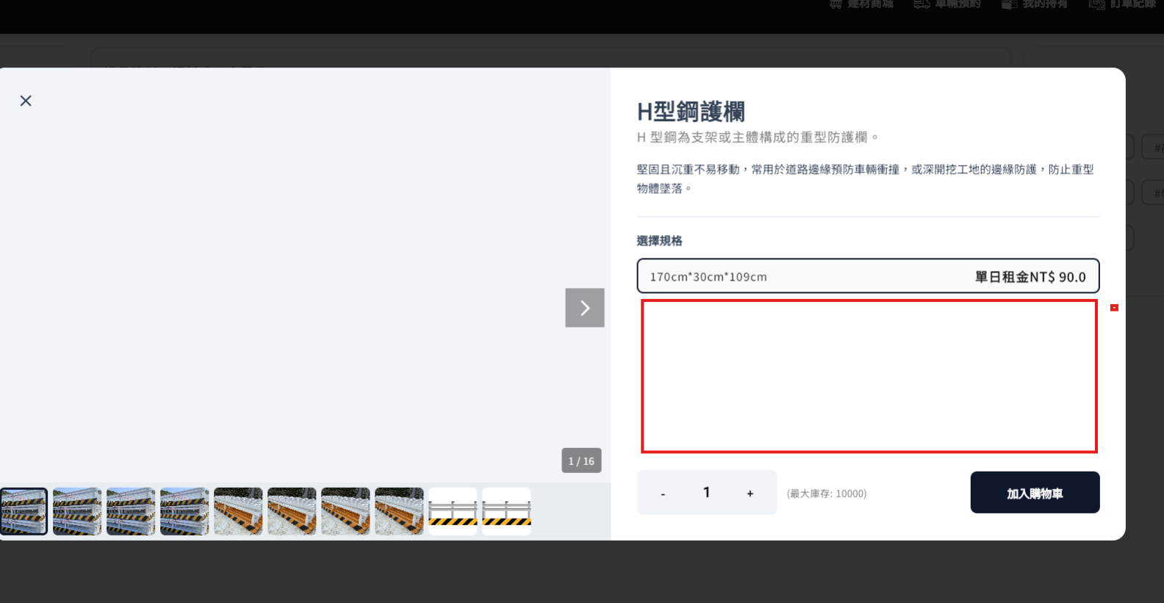
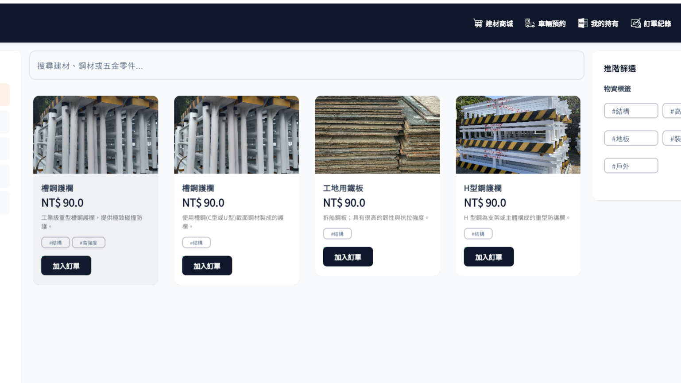

訂購平台 租用
鋼軌 的 訂購WEB不想顯示這麼多項,可能要和在同一個表格程有多個品項可以選
同一個畫面顯示多種規格 可以一次訂購完成
4、5、6、7、8、9、10、11、12、13
等於 上架 規格
等於 ATTRIBUTE
數量 | 規格 | 單位 | 購買數量
Qty | Name | Unit

Slide 7
mark/mall/list
Server | Method | Request Param | Response Param
https://localhost: | GET | userId INT ctProtypeId INT catId INT? tagId string? Name string? | public class Data { public int productId public string ProductName public List<string> TagNames public int CtProductCatId public string ShortDes public string FsId public List<shelfls> sls public class shelfls { public int ShelfId public int Qty public decimal Price } }

Slide 8
mark/mall/detail
Server | Method | Request Param | Response Param
https://localhost: | GET | userId INT proName string | public class Detail { public int ProductId public string ProductName public int CtProductCatId public string ShortDes public decimal Price public List<string> FsId public string Description public List<Attribute> Attributes public class Attribute { public int Qty public int ShelfId public string Name public string Unit } }

