Slide 1
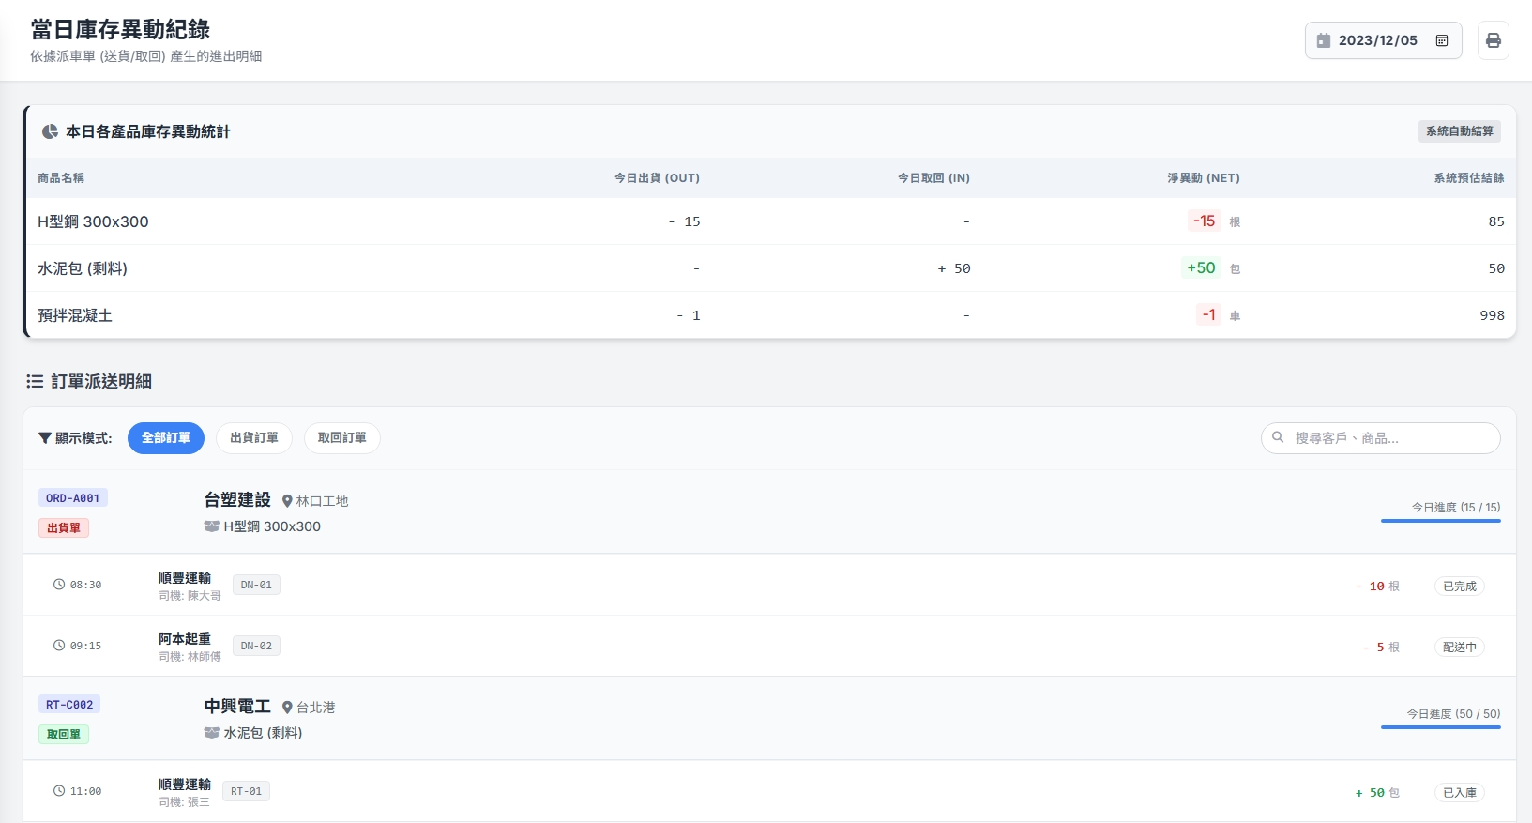


Date | App / Web | Protocol | description
2026/03/03 | Web | Api | 當日異動紀錄
yyyy/MM/dd
~
yyyy/MM/dd
客戶 :
客戶公司 :
廠區 :
產品名稱 : XXXXXX
規格 :

Slide 2
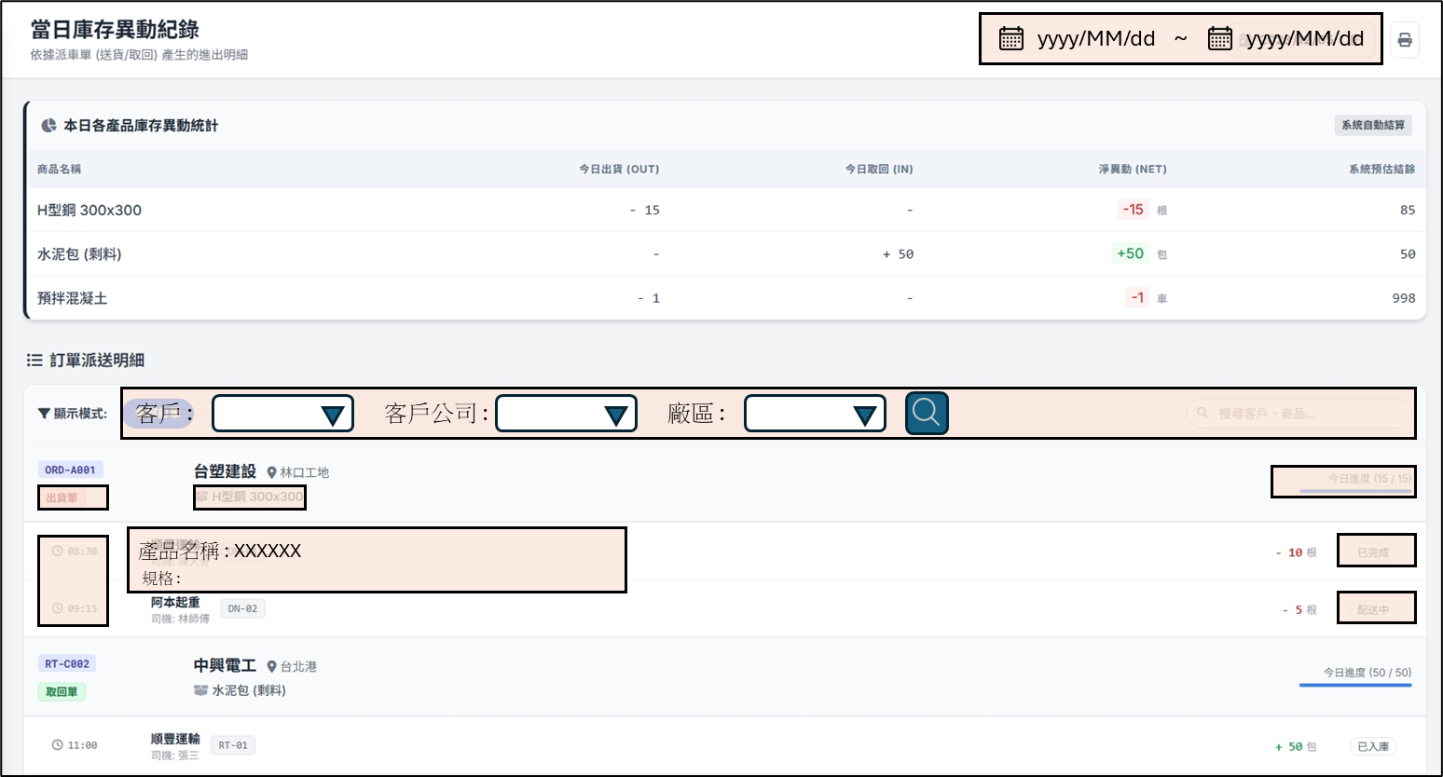
進入頁面
API
完成
mgmt/inventory/changes
mgmt/ct/custinfo/filter

Slide 3
選擇
篩選項目
API
更新項目
mgmt/ct/custinfo/filter

Slide 4
點下搜尋
API
完成
mgmt/order/history/search

Slide 5
mgmt/inventory/changes
Server | Method | Request Param | Response Param
https://localhost:7093 | GET | strDt DATETIME endDt DATETIME | List<Changes> -------------------------------------- public class Changes { public string product_no public string product_name public int? out_qty public int? in_qty public int? inv_qty }

Slide 6
mgmt/ct/custinfo/filter
Server | Method | Request Param | Response Param
https://localhost:7093 | GET | custId INT? deptId INT? facId INT? | public class CustomerFilter { public List<CustomerPartial> customers public List<DepartmentPartial> depts public List<FacilityPartial> facilities public class CustomerPartial { public int custId public string cust_no public string cust_name public string phone } public class DepartmentPartial { public int deptId public string dept_no public string dept_name public string dept_region public string dept_address } public class FacilityPartial { public int facId public string facNo public string facName public string facRegion public string facAddress } }

Slide 7
mgmt/order/history/search
Server | Method | Request Param | Response Param
https://localhost:7093 | Post | public class SearchBody { public int? custId public int? depId public int? facId public DateTime strDt public DateTime endDt } | public class OrderHistory { public long soId public string soNo public List<Item> items public class Item { public string goodsName public string ctSoTypeName public float length public float width public float height public float weight public string regionFrom public string regionFromCode public string addrFrom public string userFrom public string regionTo public string regionToCode public string addrTo public string userTo } }

