Slide 1
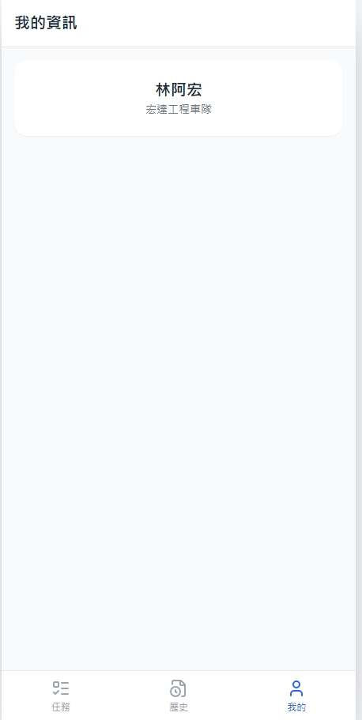
Date | App / Web | Protocol | description
2026/02/25 | App | Api | 司機登入後基本資料

Slide 2
進入頁面
API
完成
app/user/info
[driver_name]
[comp_name]

Slide 3
app/user/info
Server | Method | Request Param | Response Param
https://localhost:7093 | GET | driverId INT | public class DriverInfo { public string driverNo public string driverName public string licensePlate public string compNo public string compName }

